Slide 1
Binary search trees
Dr. Yasir | Programming Domain

Slide 2
Binary search tree
In a Binary search tree, the value of left node must be smaller than the parent node
the value of right node must be greater than the parent node.
This rule is applied recursively to the left and right subtrees of the root.
Notes:
Insert a map of your country.

Slide 3
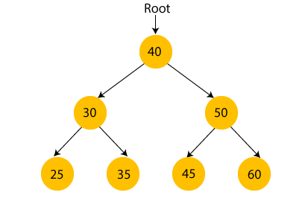
Binary search tree
Notes:
Insert a map of your country.

Slide 4
advantages
Searching an element in the Binary search tree is easy as we always have a hint that which subtree has the desired element.
As compared to array and linked lists, insertion and deletion operations are faster in BST.
Notes:
Insert a map of your country.

Slide 5

creating a binary search tree
45, 15, 79, 90, 10, 55, 12, 20, 50
First, we have to insert 45 into the tree as the root of the tree.
Notes:
Insert a map of your country.

Slide 6
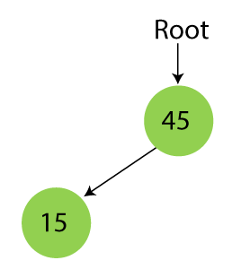
Binary search tree
Step 2 - Insert 15.
As 15 is smaller than 45, so insert it as the root node of the left subtree
Notes:
Insert a map of your country.

Slide 7
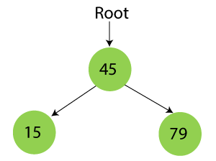
Binary search tree
Step 3 - Insert 79.
As 79 is greater than 45, so insert it as the root node of the right subtree.
Notes:
Insert a map of your country.

Slide 8
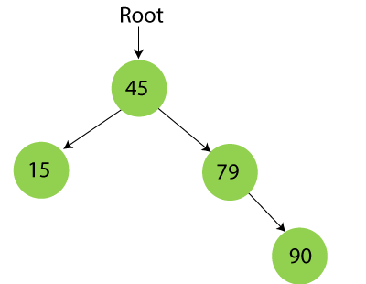
Binary search tree
Step 4 - Insert 90.
90 is greater than 45 and 79, so it will be inserted as the right subtree of 79
Notes:
Insert a map of your country.

Slide 9
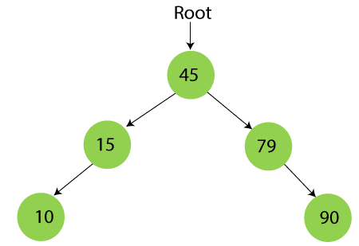
Binary search tree
Step 5 - Insert 10.
10 is smaller than 45 and 15, so it will be inserted as a left subtree of 15.
Notes:
Insert a map of your country.

Slide 10
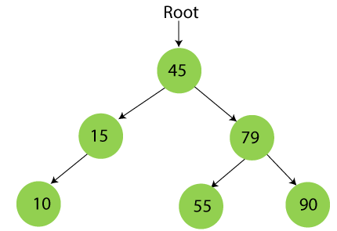
Binary search tree
Step 6 - Insert 55.
55 is larger than 45 and smaller than 79, so it will be inserted as the left subtree of 79.
Notes:
Insert a map of your country.

Slide 11
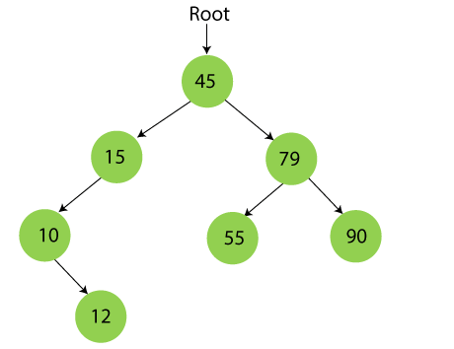
Binary search tree
Step 7 - Insert 12.
12 is smaller than 45 and 15 but greater than 10, so it will be inserted as the right subtree of 10.
Notes:
Insert a map of your country.

Slide 12
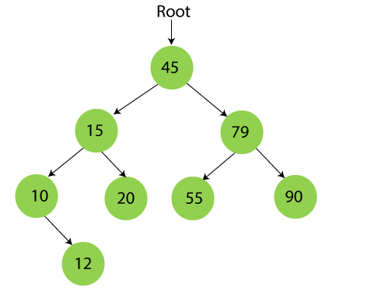
Binary search tree
Step 8 - Insert 20.
20 is smaller than 45 but greater than 15, so it will be inserted as the right subtree of 15.
Notes:
Insert a map of your country.

Slide 13
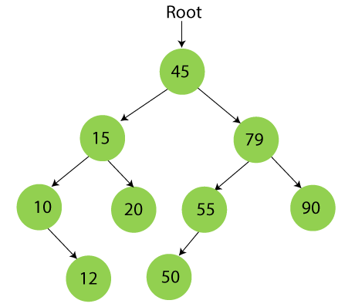
Binary search tree
Step 9 - Insert 50.
50 is greater than 45 but smaller than 79 and 55. So, it will be inserted as a left subtree of 55.
Notes:
Insert a map of your country.

Slide 14
Elements: 50, 30, 20, 40, 70, 60, 80

Slide 15
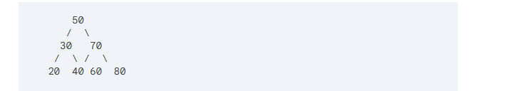
Elements: 50, 30, 20, 40, 70, 60, 80

Slide 16
Algorithm to search an element in Binary search tree
Search (root, item)
Step 1 - if (item = root → data) or (root = NULL)
return root
else if (item < root → data)
return Search(root → left, item)
else
return Search(root → right, item)
END if
Step 2 - END
Notes:
Insert a map of your country.

Slide 17
Insertion in Binary Search tree
A new key in BST is always inserted at the leaf.
To insert an element in BST, we have to start searching from the root node
if the node to be inserted is less than the root node, then search for an empty location in the left subtree.
Else, search for the empty location in the right subtree and insert the data
Notes:
Insert a map of your country.

Slide 18
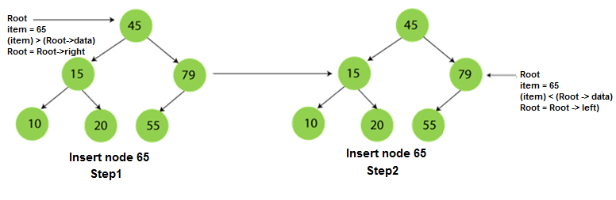
Notes:
Insert a map of your country.

Slide 19
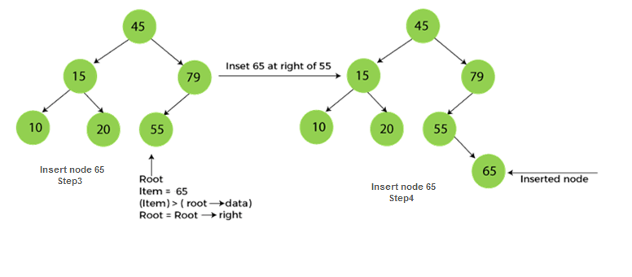
Notes:
Insert a map of your country.

Slide 20
Deletion in Binary Search tree
In a binary search tree, we must delete a node from the tree by keeping in mind that the property of BST is not violated. To delete a node from BST, there are three possible situations occur -
The node to be deleted is the leaf node, or,
The node to be deleted has only one child, and,
The node to be deleted has two children
Notes:
Insert a map of your country.

Slide 21
When the node to be deleted is the leaf node
It is the simplest case to delete a node in BST. Here, we have to replace the leaf node with NULL and simply free the allocated space.
We can see the process to delete a leaf node from BST in the below image.
Notes:
Insert a map of your country.

Slide 22
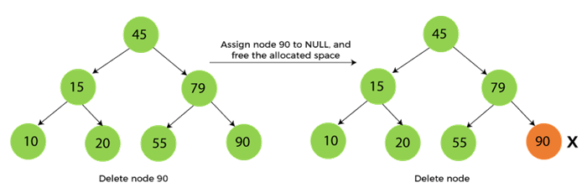
.In below image, suppose we have to delete node 90, as the node to be deleted is a leaf node, so it will be replaced with NULL, and the allocated space will free
Notes:
Insert a map of your country.

Slide 23
When the node to be deleted has only one child
In this case, we have to replace the target node with its child, and then delete the child node.
It means that after replacing the target node with its child node, the child node will now contain the value to be deleted.
So, we simply have to replace the child node with NULL and free up the allocated space.
Notes:
Insert a map of your country.

Slide 24
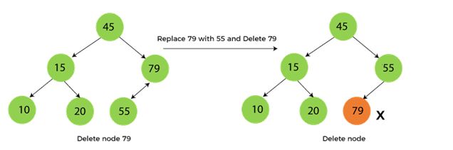
We can see the process of deleting a node with one child from BST in the below image.
In the below image, suppose we have to delete the node 79, as the node to be deleted has only one child, so it will be replaced with its child 55.
So, the replaced node 79 will now be a leaf node that can be easily deleted
Notes:
Insert a map of your country.

Slide 25
When the node to be deleted has two children
This case of deleting a node in BST is a bit complex among other two cases. In such a case, the steps to be followed are listed as follows -
First, find the inorder successor of the node to be deleted.
After that, replace that node with the inorder successor until the target node is placed at the leaf of tree.
And at last, replace the node with NULL and free up the allocated space.
Notes:
Insert a map of your country.

Slide 26
The inorder successor is required when the right child of the node is not empty. We can obtain the inorder successor by finding the minimum element in the right child of the node.
We can see the process of deleting a node with two children from BST in the below image.
Notes:
Insert a map of your country.

Slide 27
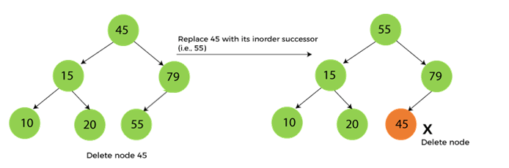
‘
In the below image, suppose we have to delete node 45 that is the root node, as the node to be deleted has two children, so it will be replaced with its inorder successor. Now, node 45 will be at the leaf of the tree so that it can be deleted easily
Notes:
Insert a map of your country.

Slide 28
Time COMPLEXITY
BST

